Slide 1
Earthquake time-series forecasts in California
Audience: Local state agency
Notes:
Ok, so the topic of my presentation is using time-series predictions to see any possibilities for forecasting earthquakes in the state of California.

Slide 2
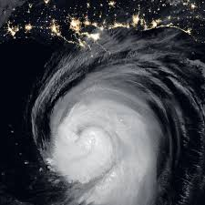
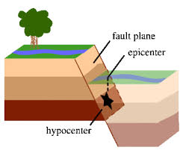
How is our forecast ability for Natural disasters ?
Hurricane Laura
Earthquakes
Fault plane
Epicenter
?
Days ahead forecast!
Audience: Local state agency
Notes:
If you have followed the recent news, the news gave us live updates on the hurricane laura and how it develops and when it is expected to hit the ground.
This seems like a fancy precatory ML tool, which thanks to the satellite imagery makes it possible to do so. [click]
However, when it comes to Earthquakes, we do not have that capability. The main reason for that is we have very limited knowledge of earth structure subsurface and the fault structure that lead to the generated earthquakes. [click]

Slide 3
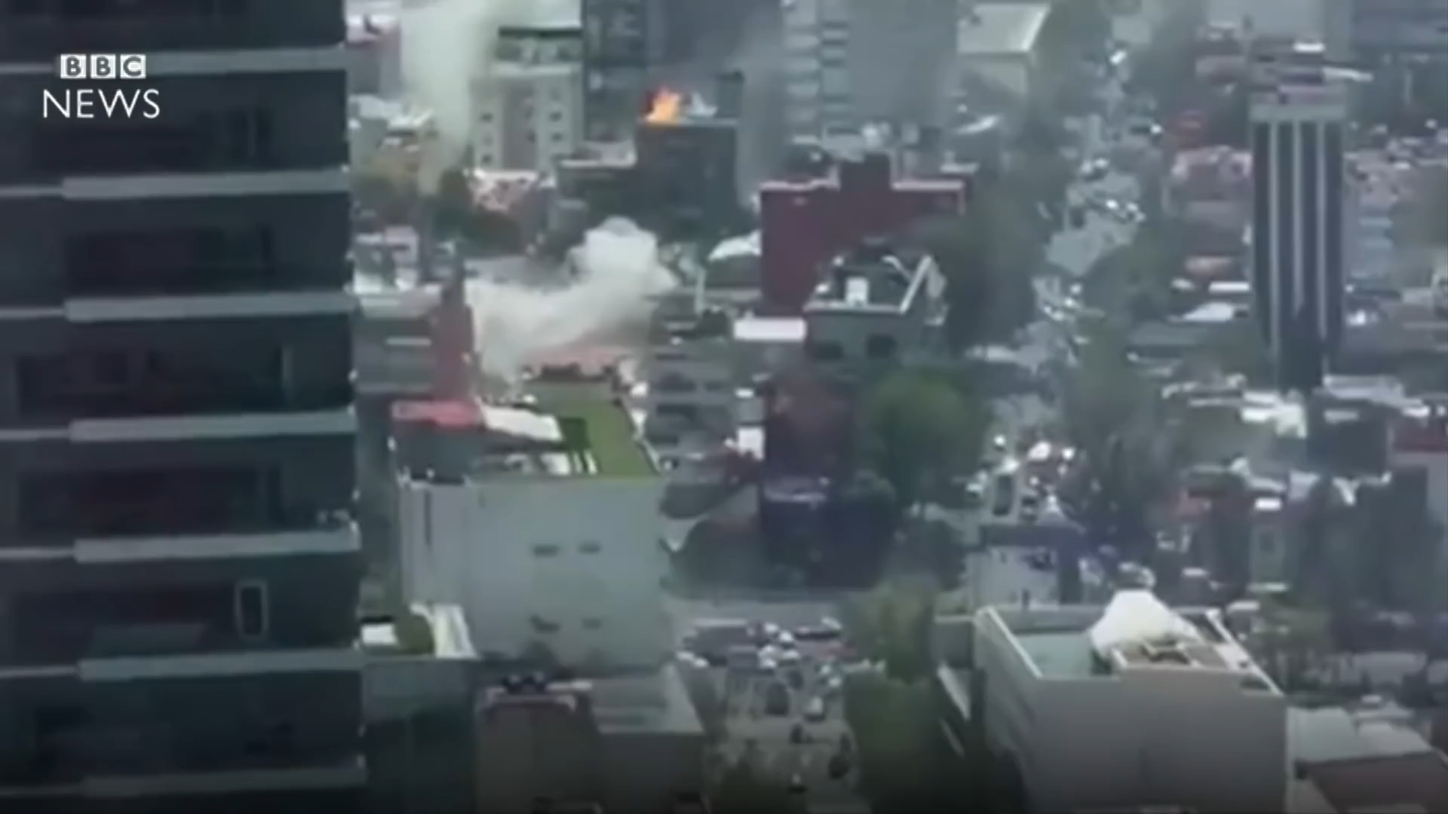
How is our forecast ability for Natural disasters ?
Hurricane Laura
Earthquakes [Source: BBC news]
>217 death during 2017 Mexico City’s 7.1 EQ
Days ahead forecast!
Seconds ahead forecast!
Audience: Local state agency
Notes:
And unfortunately the best we can do is only a few seconds, and even that one is not predictory and is based on physics-based model of ground shakes.
So, imagine an earthquake happens in LA, and we know within some time the generated wave is gonna travel and reach to Santa Barbara, so they send out alerts to the local's phones to get shelter.
And, because of this inability, we pay a high price of death costs, which is due to the lack of preparation.
For example, in this video, I’m showing the 2017 Mexico city earthquake which took nearly 200 lives. Let's watch the video. So, I don't think a few seconds is enough to run out of this horrible mess [click]
I tried to see whether I can use the earthquake data for hopes to forecast earthquakes.

Slide 4
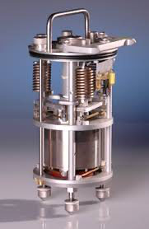
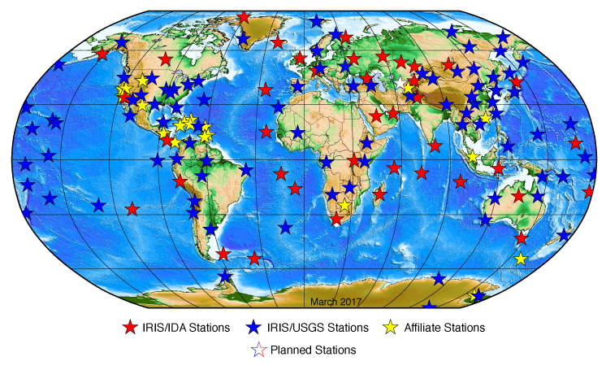
Global seismic network: USGS API
Audience: Local state agency
Notes:
The data comes from the global seismic network which is located globally around the world. These stations are basically accelerometer or seismometers, just like the ones in our iphones, which continuously record ground shakes.
Thankfully, these data are available by united states geological survey (USGS). So, I downloaded the data from their API.
So, as a Californian … [click]

Slide 5
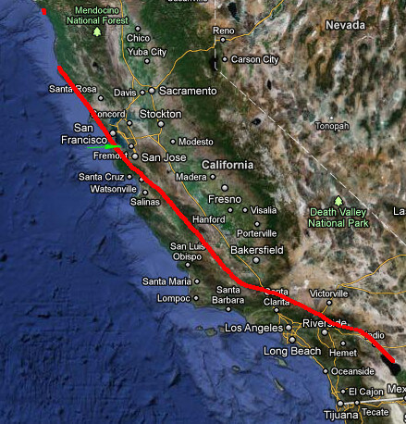
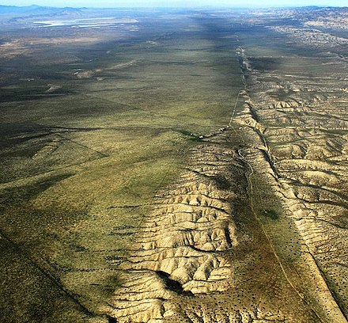
San Andreas fault: Where Californians are susceptible
Loma Prieta Earthquake (1989) [Source: Montclair]
San Andreas fault aerial view [Source: Wikipedia]
Notes:
I selected San Andreas fault which extends about 700 miles from north all the way to the south California, as you can see in the left- hand side map. And, the red arrows show the sense of motion of the plates. And, if I’m not mistaken, as I am sitting here in San Jose, in average I’m getting nearly 4 cm closer to LA every year. But, of course it is way more complicated and depends on the plate behavior.
And, in the right-hand side you can see the aerial vie of the surface exposure of this fault.
This fault is responsible for the notorious 1906 San Francisco earthquake and many other historic earthquakes, such as [click]
Loma Prieta, in California. Which happened in 1989.

Slide 6
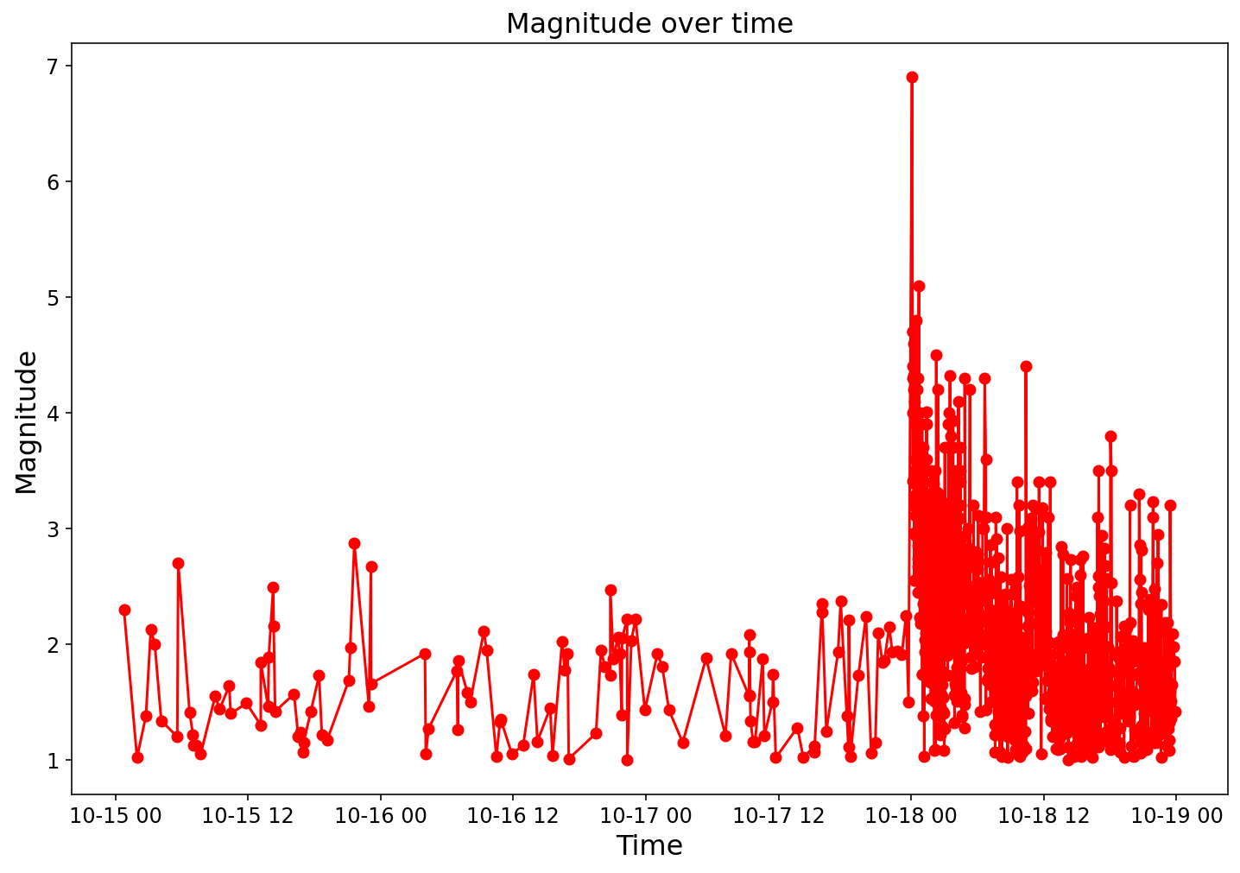
Why earthquakes are so difficult to predict?
(Loma Prieta EQ)
63 deaths!
Foreshocks!
Aftershocks!
Notes:
But, if we have this data, why we do not have yet a representative predictory model for earthquakes.
Here, I am plotting the earthquake magnitude overtime that happened leading to the main earthquake in loma prieta which took 63 lives. Just some terminologies, when we say foreshocks we refer to all the small earthquakes that happened before and aftershocks after that.
So, as you can see, almost there is no indication of the main shock happening, and all of a sudden, we have the main earthquakes, so this immediately suggests that simple time-series analysis would not be able to capture this main earthquake event.
Also, one alternative would be using more complex models such as deep learning to detect time-series anomalies, however we need to keep in mind that these data are very limited in number. So, we need alternative methods.
Knowing that let’s now, dig into models.

Slide 7
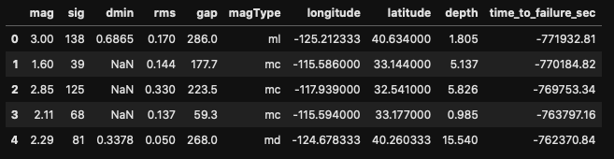
Loma Prieta Earthquake
Target label: time to failure
Simple regression model failed badly (R²=0.08)!
Because, the system is highly non-linear.
Notes:
So, I imported the earthquake data and labeled the data with time to the main failure as a target label.
So, the EQ data has description of magnitudes, 3D locations, and the location accuracy.
So, as an initial model, we ran a simple regression model, which failed badly, as I explained due to the anomaly nature of the main earthquake and high non-linearities.
So, I looked into alternative modeling efforts.

Slide 8
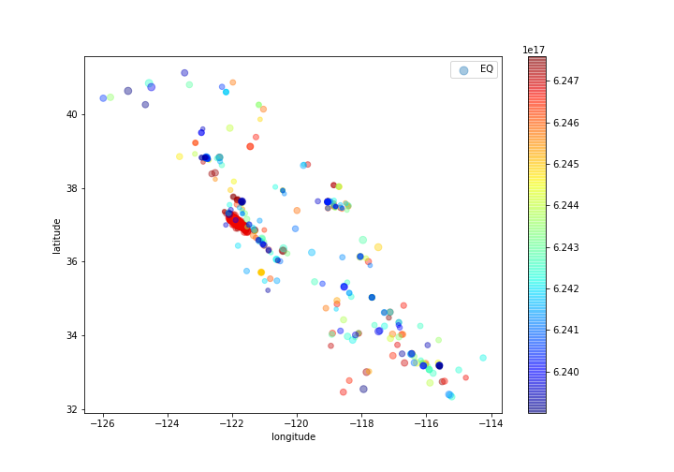
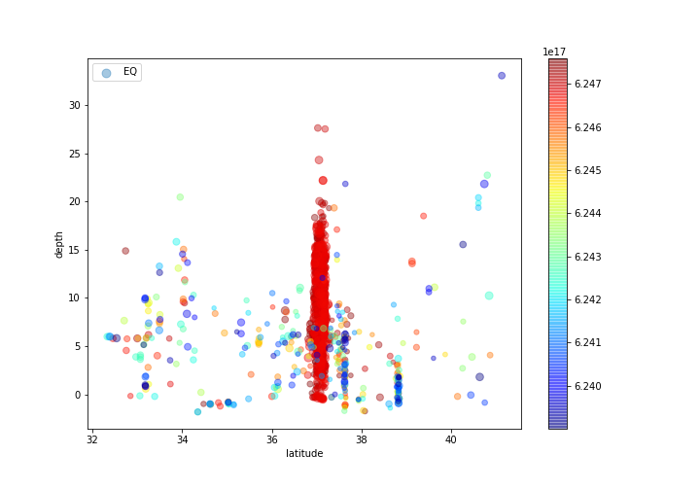
Loma Prieta EQ - 10 days
Longitude-latitude
Latitude-depth
Notes:
One place to look at is looking into the location data of the earthquakes.
As, here I show the map view and also vertical profile of the images.
So, you can see before the main shock happens we have dispersed events all over the place, and as we get close to the main event things cluster spatially. [click]
However, the vertical profile has a different story, as we get close to main failure, things start to happen more dispersedly, As, events can go as deep as 20 kilometers.
And, I have to say the dangerous events are the shallow ones, which travel with high energy into the surface.

Slide 9
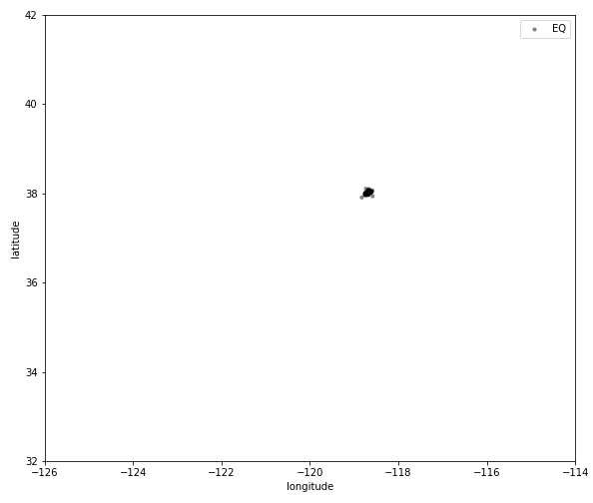
Hybrid model: 3D clustering (DBSCAN) + Regression
Target label: time to failure
Features:
1- event density
2 - aspect ratio (std)
3 – mass center transformation
Top cluster
Notes:
So, I tried this idea of having a hybrid model, where first I would cluster events historically, and then use these clusters to infer features.
So, think about this top cluster that initiated 10 days before the main failure. [click]
This cluster can travel to multiple directions with time. [click]
And, from these dynamic changes, we can in fact infer some feature parameters.
For starters, we can start looking into the
1 - Event density,
2 - Aspect ratio, for example how does the cluster look like, does it look like sphere, ellipsoidal and so on.
3 - And, finally how does the cluster travel, does it remain static, does it move,

Slide 10
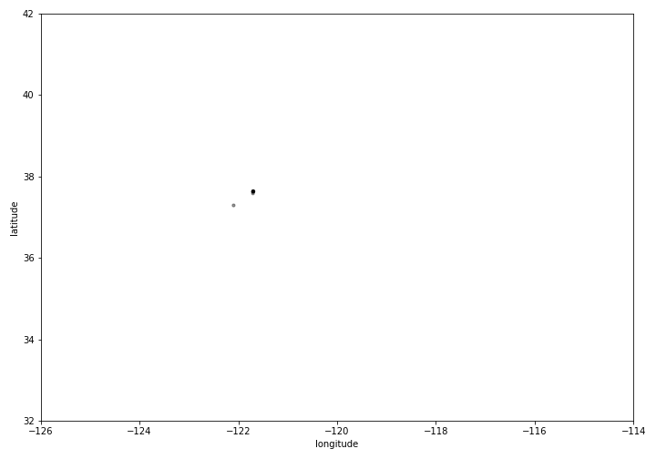
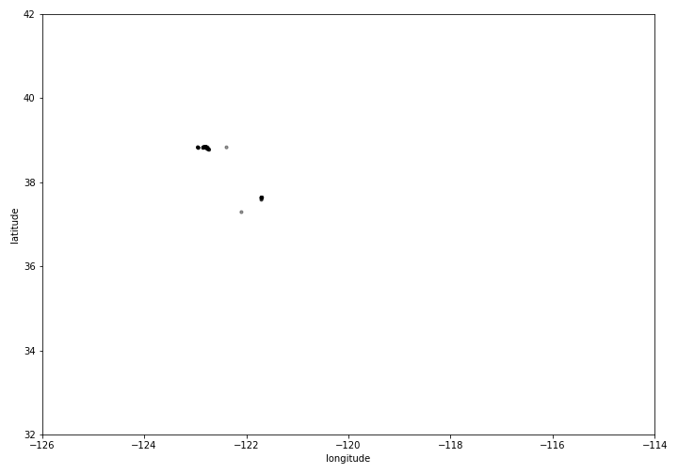

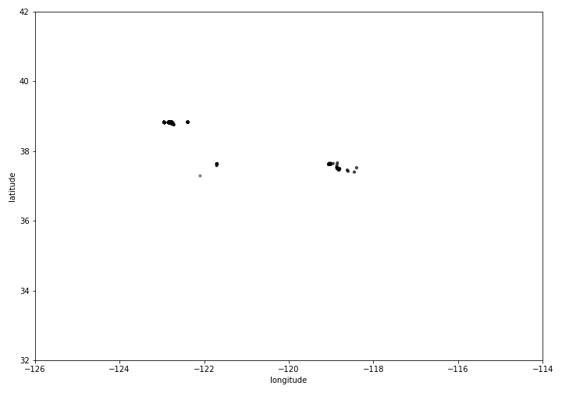
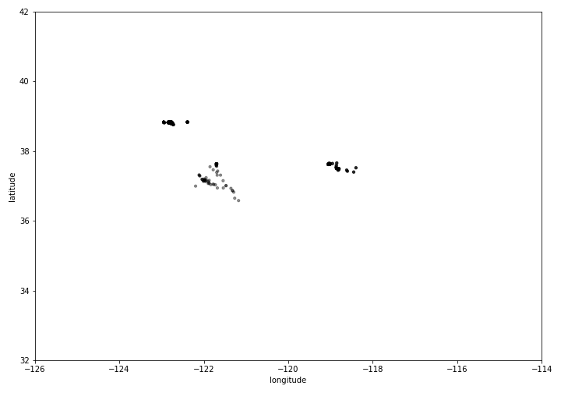
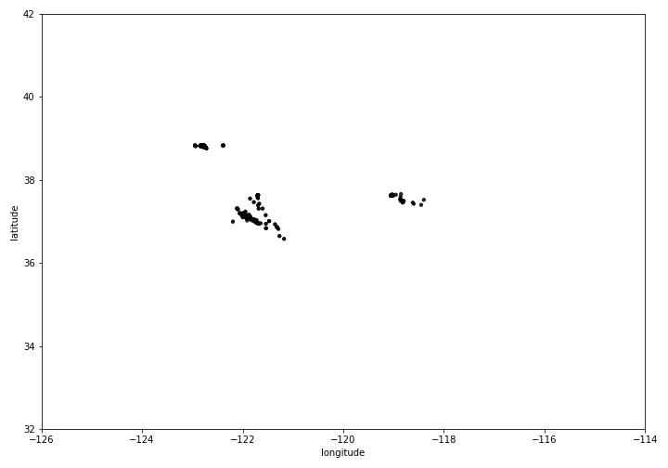
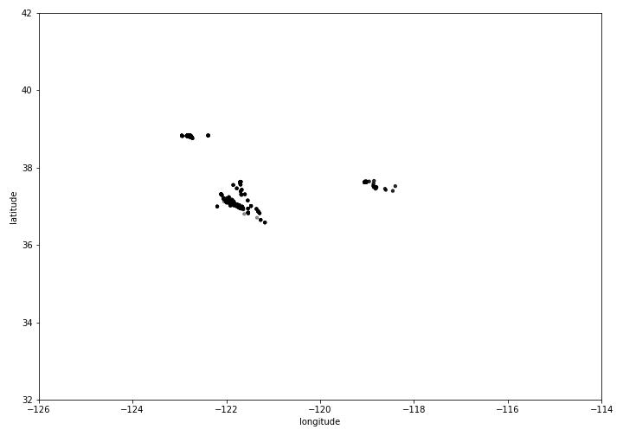




Cluster behavior in 10 days
Features:
1- event density
2 - aspect ratio (std)
3 – mass center transformation
Notes:
Here, I’m just showing an image sequency on how these cluster traveled. So, first they started sparse, and then traveled back and forth and finally remained stationary and densified.

Slide 11
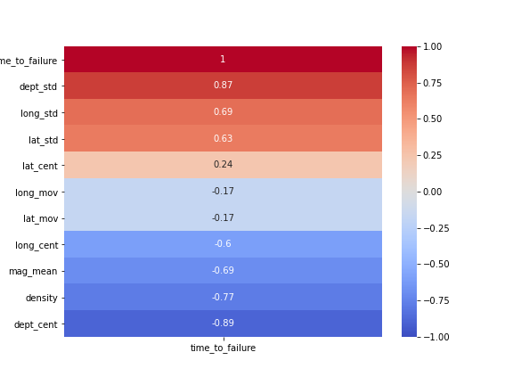
Hybrid model: 3D clustering (DBSCAN) + Regression
Target label: time to failure
Features:
1- event density
2 - aspect ratio (std)
3 – mass center transformation
Clustering seems to have taken enough of non-linearity into account!
Notes:
So, analyzing the correlation between the engineered features, we can actually see a decent correlation.
And, some interesting observations emerge. For example, all these engineered features have strong correlation with the target, which is time to failure.

Slide 12
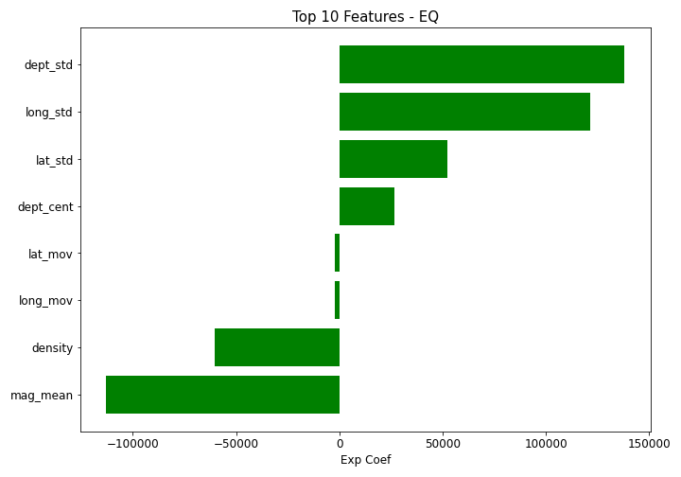
Hybrid model performance
R² = 0.89
We can explain 89% variability in the time to failure.

Slide 13
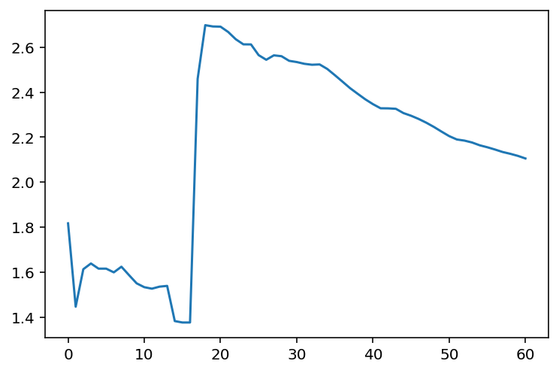
Time-averaged magnitude

Slide 14
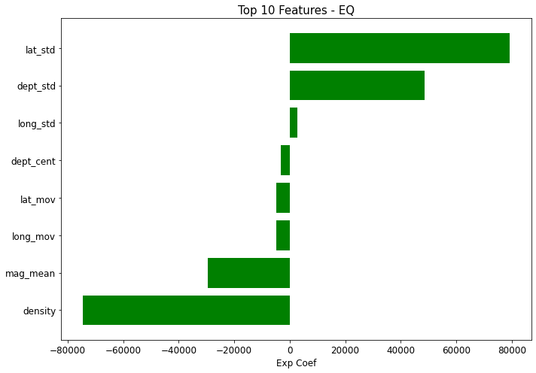
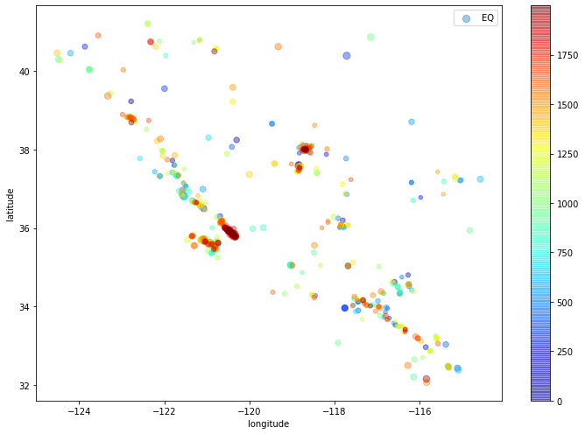
Future work
New dataset: Parkfield EQ (2004)
R² = 0.98

Slide 15
Interesting facts
If the San Andreas Fault were to rupture end-to-end (~1400km), with ~10m of average slip, it would produce an earthquake of M 8.47.
Image source: Montclair

Slide 16
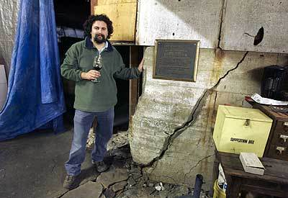
Recommendation
Apply this analysis to other earthquakes in other fault systems and see whether it generalizes.
If it generalizes, then using the wealth of data to look into deep learning techniques in detecting these times-series anomalies
San Andreas fault!
DeRose Vineyards

